Slide 1
An overview of “Untargeted Metabolic Analysis of Lactation-Stage-Matched Human and Bovine Milk Samples at 2 Weeks Postnatal”
By Véronique Godoy, Yuze Guo, & Kay Johnson

Slide 2













Student profile: Kay

Slide 3
Introduction
Data indicate that bovine whole milk is frequently used as a substitute for human milk during the first 12 months; may be linked to adverse infant health outcomes.
Study objective: To analyze and compare the metabolomic profiles of human and bovine milk collected at 2 weeks postpartum to identify unique metabolites that could influence infant health.

Slide 4
Background
Human milk contains unique oligosaccharides, lipids, and bioactive peptides that influence digestion, metabolism, and microbiome interactions. Bovine milk lacks comparable HMO diversity.
Why metabolomics? Provides a detailed biochemical fingerprint beyond macronutrients, identifying functional metabolites that impact infant gut health, metabolism, and immune function.
Relevance: Findings can improve infant formula composition and guide the development of alternatives that better mimic human milk.

Slide 5
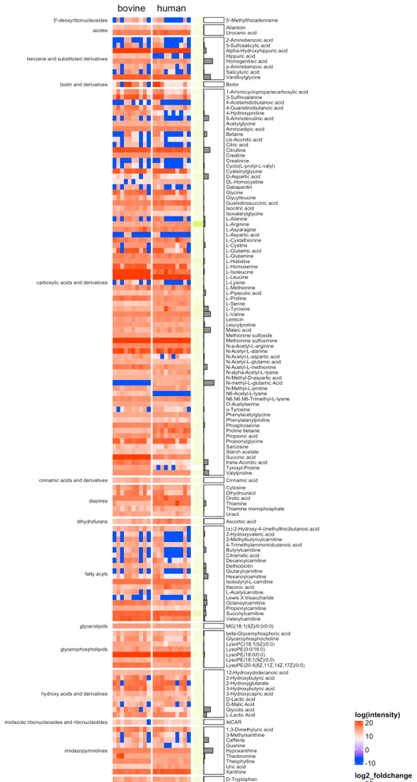
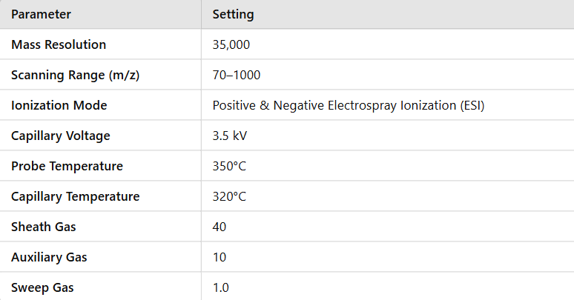
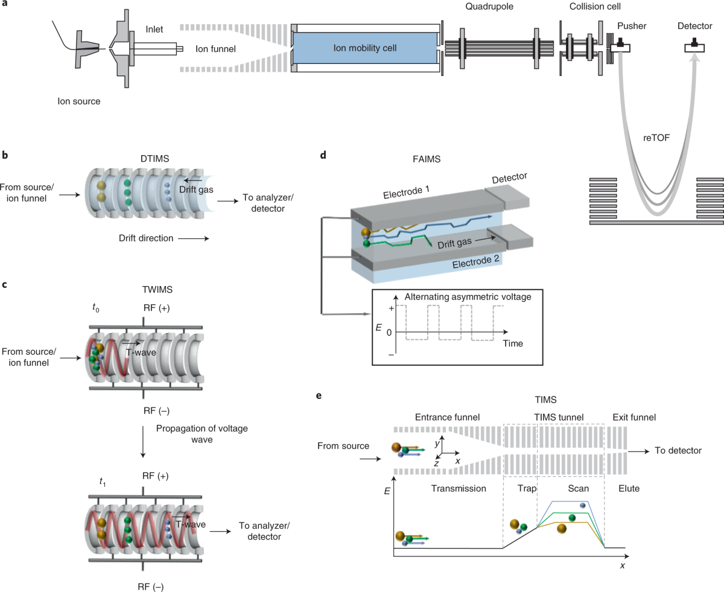
Methodology
Milk Collection and Handling
-Participants (36-38 weeks pregnant)
-Time of collection (2 weeks postpartum)
Metabolite extraction (Figure 1)
-Reagents used were LC-MS grade.
-Blank samples used deionized water.
Analytical instrumentation (Figure 2 & 3)
Figure 2: Ultra-high-performance liquid chromatography–high-resolution mass spectrometry (UHPLC-HRMS) settings.
Figure 1: results from metabolite extraction.
Figure 3: UHPL-HRNS machine

Slide 6
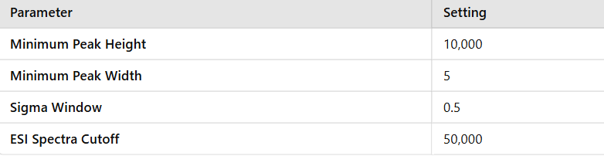
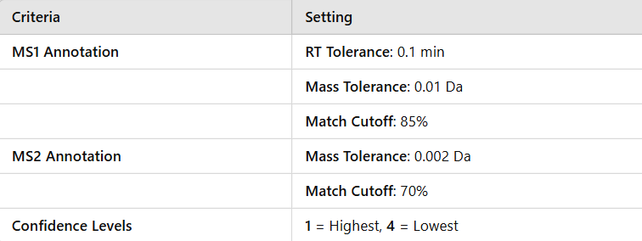
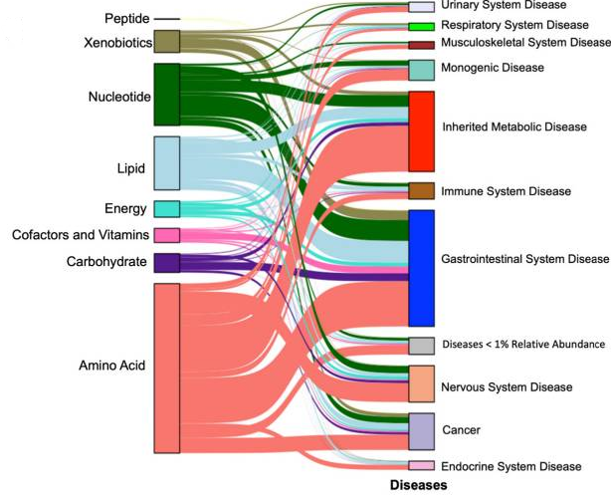
Methodology
Figure 4: MS-DIAL v4.45 settings.
4. Data processing
-Raw file converted to mzML format using ProteoWizard-msConvert.
-Signal processing using MS-DIAL v4.45 (Figure 4 for settings).
-Metabolic annotation (SECIM Core, MassBank, HMDB, MoNa). (Figure 5)
-Peak Alignment and Noise Removal (removal of S/N ratio < 5)
-LOWES algorithm used for peak normalization.
-MS-FLO used for post-processing.
5. Statistical analysis
- Sankey plot (Figure 6)
Figure 5: Metabolic annotation settings.
Figure 6: Sankey plot. Connection of metabolite to diseases.

Slide 7
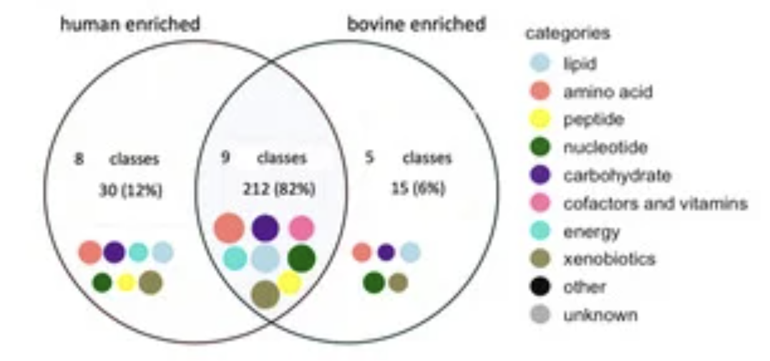
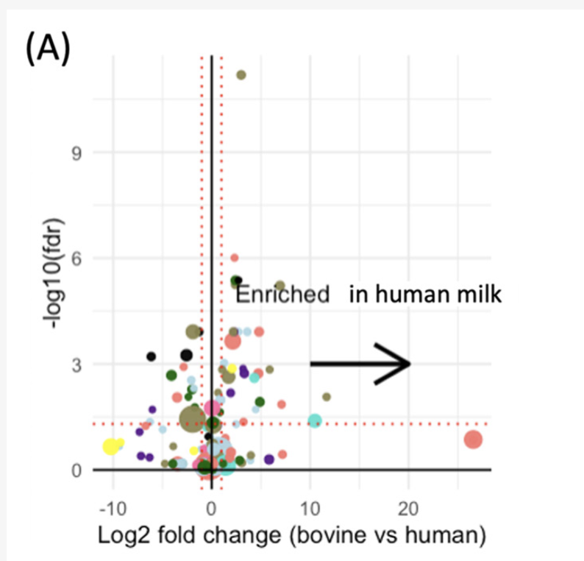
Results
46 metabolites significantly differed between human and bovine milk
Top metabolite classes:
• Amino acids (23.7%)
• Xenobiotics (15.18%)
• Nucleotides (11.67%)
• Carbohydrates (9.73%)
• Lipids (8.56%)
• Low-abundance classes (<5%):
• Vitamins, cofactors, energy metabolism, and peptides.
Amino acids had the most metabolite–disease links.

Slide 8
Discussion of previous work & new focus
Comprehensive bovine milk assessment by using NMR, LC-MS, and ICP-MS; Some components are more abundant than others; reduce intestinal inflammation (HMO)
Several metabolites enriched in human samples that can participate directly in microbe–host interactions and are beneficial to infant’s growth include but not limited to improving glucose homeostasis and regulate specific types of inflammation

Slide 9
Discussion of results
Cow-milk based formula is the predominate substitution of human milk
Essential to know the difference in composition of human and bovine milk to study the effect of the distinguished metabolites on infants health
80% of the metabolites in the two types of milk are shared
80% of the milk metabolites may contribute to microbe-host interaction in infant’s GI tract
Milk metabolites have a pleiotropic impact on health outcomes
18 milk metabolites that were significantly different between human and bovine samples and have not been previously reported

Slide 10
Implications & future directions
Significance: Insights from metabolomics can improve infant nutrition, particularly for those who rely on bovine-based formulas.
Future research:
Investigate functional effects of unique metabolites on infant gut health.
Explore potential formula modifications to better mimic human milk’s bioactive composition.

Slide 11
Thank you for listening!
Information sourced from: https://doi.org/10.3390/nu15173768

